Slide 1
Findings from HR Survey Data.
Kshitij K

Slide 2
Basic Statistics of data
Shape of dataset | 420*6
Number of blank rows | 4
Number of blank cells (null) | 151*
Completely filled rows | 338
Number of invalid entries | 23+
Linear correlation | None
*excluding blank rows

Slide 3
Details on columns
Columns | Number of blank spaces
gender | 6
age | 10
height | 27
weight | 36
weekly_hours | 49
stress | 23

Slide 4
Details on columns(extra)
Columns | Number of confirmed invalid
gender | 2
age | 4+
height | 14+
weight | 2+
weekly_hours | 3+
stress | 0
** these were manually corrected

Slide 5
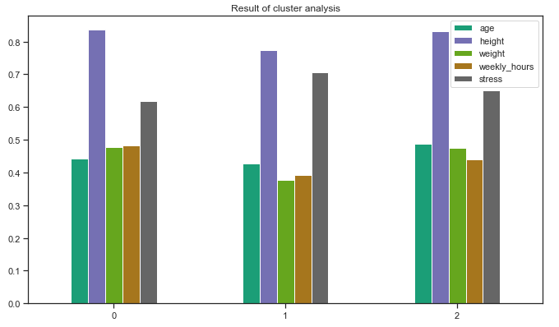
Result of cluster analysis

Slide 6
Key takeaways / Findings
Usually done to know how many segments are we dealing with.
In this case it also denotes how many minimum number of solutions will be needed to bring some effective change depending on the nature of problem and proposed solution.
So we can see that there are mainly 3 types of segments:
Moderate age, high weekly hours & less stress
Young, less weekly hours & high stress
Aged, moderate weekly hours and moderate stress

Slide 7
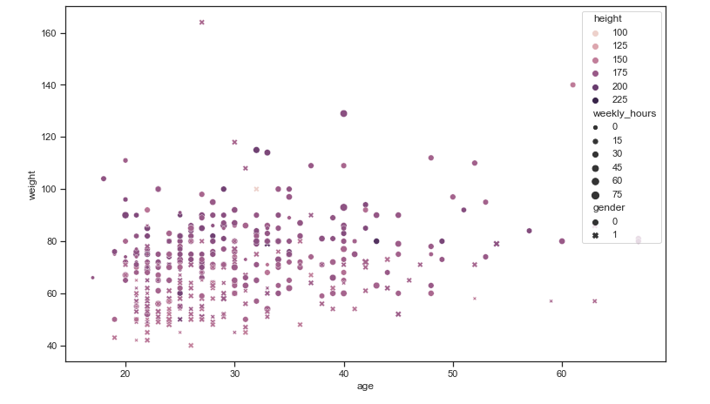
5D-scatter plot of the dataset

Slide 8
Key takeaways / Findings
Mainly the females and males are segmented according to their features
Out of which we can observe that comparatively men have more working hours
And maybe women are more health conscious and short

Slide 9
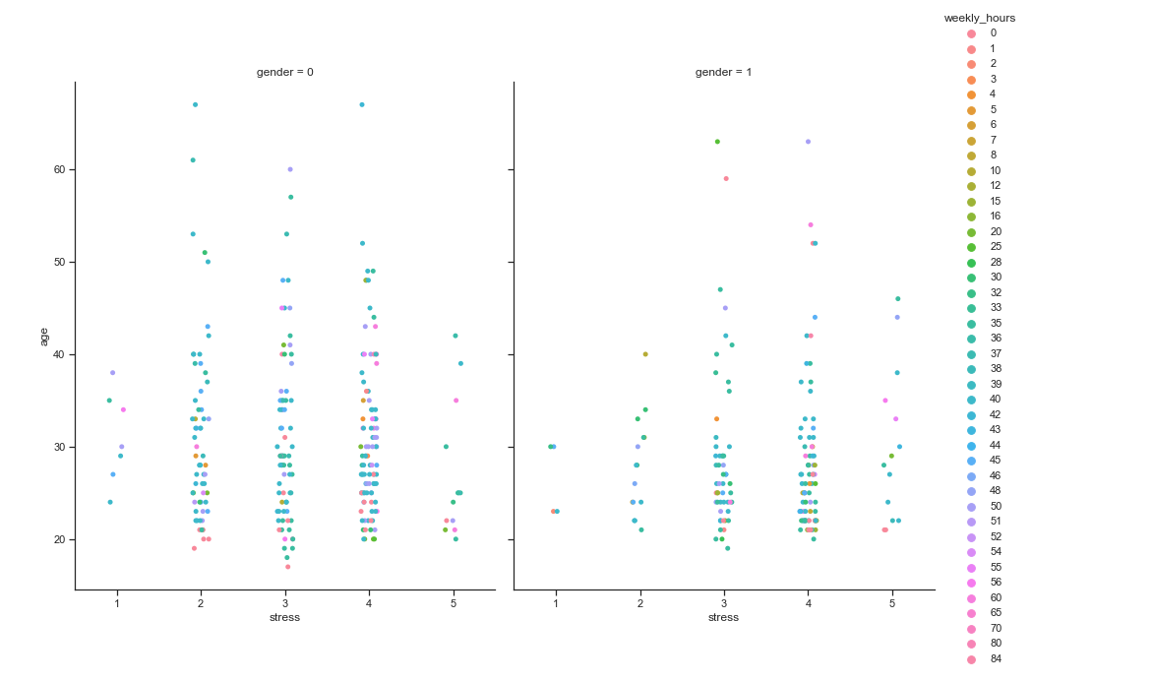
Better visualization of variables wrt stress
** gender 0 is female and 1 is male respectively.

Slide 10
Key takeaways / Findings
Most of the population is in 30-50 hrs weekly hours working band
Stress levels are comparatively higher on male side whereas female side comparatively seems pretty balanced.
Majority of the population is between 20-30 years range.

Slide 11
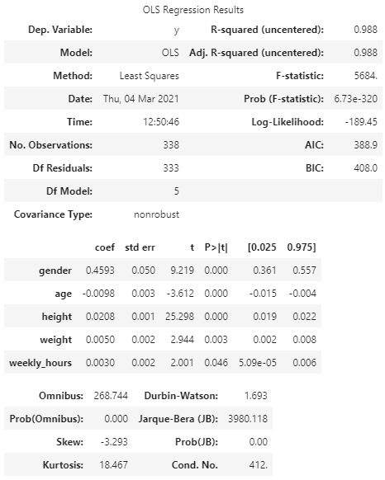
Result of Logistic Regression on datasets nulls filled with average values, after dealing with the invalid values.
Even though the accuracy of all models for prediction was very less, this model gave the best possible fit for dataset.

Slide 12
Key takeaways / Findings
The regression is carried out keeping the stress level as dependent variable
Age, height & weight is ratio-type data (independent)
Weekly hours is interval type of data (independent)
As we can see R-squared value is pretty close to 1 which denotes our model is a good fit to our data
In this case the weight and height have a pretty good co-efficient cause as observed in last graph females are pretty short in this data set resulting in high coefficient of height variable, and females are comparatively lighter than men based on body build and age.
Gender having high coefficient can be proclaimed from last graph as stress was higher in men as compared to females.
**logically speaking age and weekly hours must be the independent variables majorly responsible for deciding the value of the stress variable, but doesnt seems to be in this case.

Slide 13
Questions
At a high level, what did you need to do to prepare data for analysis?
Create, format variables
Check and modify elements that were out of bounds based on some human perception
Deal with null values and entries
Deal with invalid responses like
Detect-patterns or logic breakdown
Describe what problems, if any, did you encounter with the dataset?
Invalid responses
Null entries
Outliers
Cell Shift
Invalid entries
Data format

Slide 14
Questions
.
.
Methods used to analyze the data and are they appropriate?
Cluster analysis
Its relevant cause whenever we grade people there will always be segments that think alike, so it's good to know how many segments are there.
Logistic Regression with t-test
Completely relevant due to its classification capabilities which will help us to know in what stress range the person blends in based on other given factors
How many hours did you spend on this task?
12-15 hours

Slide 15
THANKYOU

